Slide 1
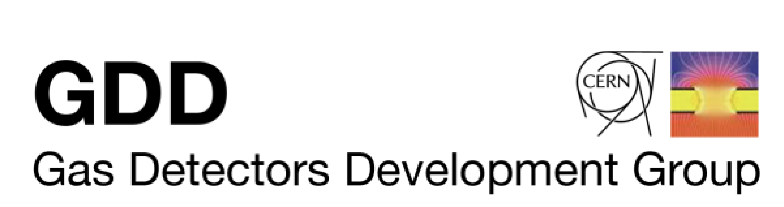



Characterization of Ar/N2 gaseous mixtures for MPGD-based detectors.
EP-DT Training Seminar
Genaro Barco
Supervisors:
Diego Gonzalez Diaz
Florian Brunbauer
Pablo Amedo
Notes:
Add DRD1 logo

Slide 2
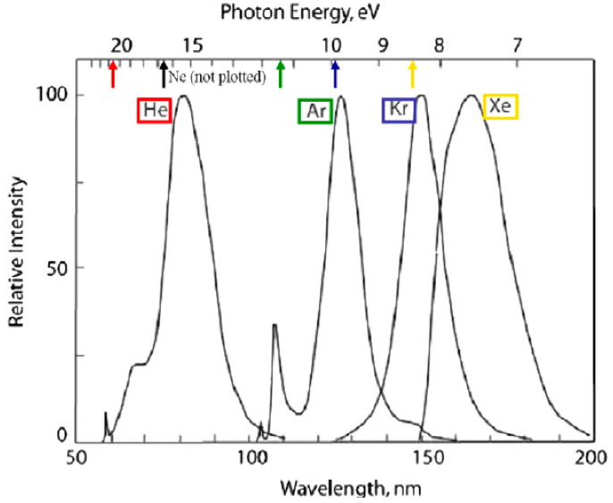
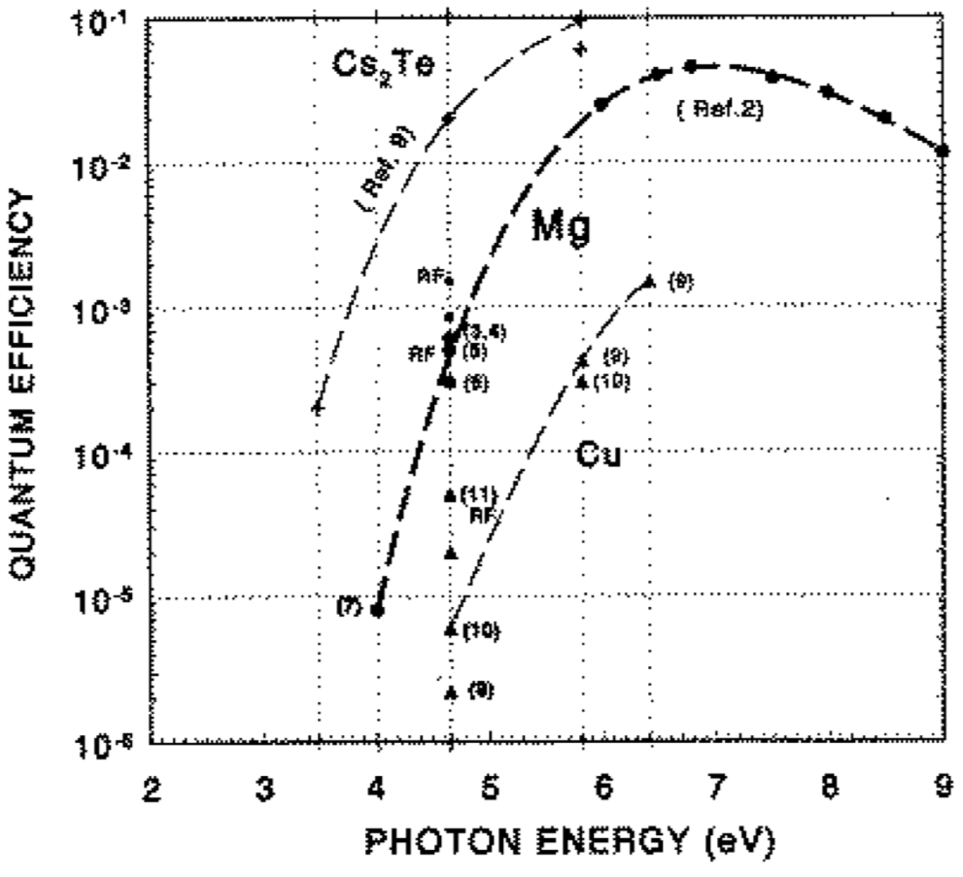
2
Technological challenge
Noble gases scintillate in the VUV (2nd continuum)
Photoelectric effect causes feedback in Gaseous detectors!
VUV -Quenchers are added to Ar (e.g., CH₄), to eliminate VUV-scintillation and increase maximum gain
D. Gonzalez Diaz - Primary Scintillation in Ar-based Mixtures Aimed at Providing a To-signal in DUNE ND-Gar – 14.09.2021
05.08.2025
Notes:
Explain what you want the quencher to transfer energy to the visible range

Slide 3
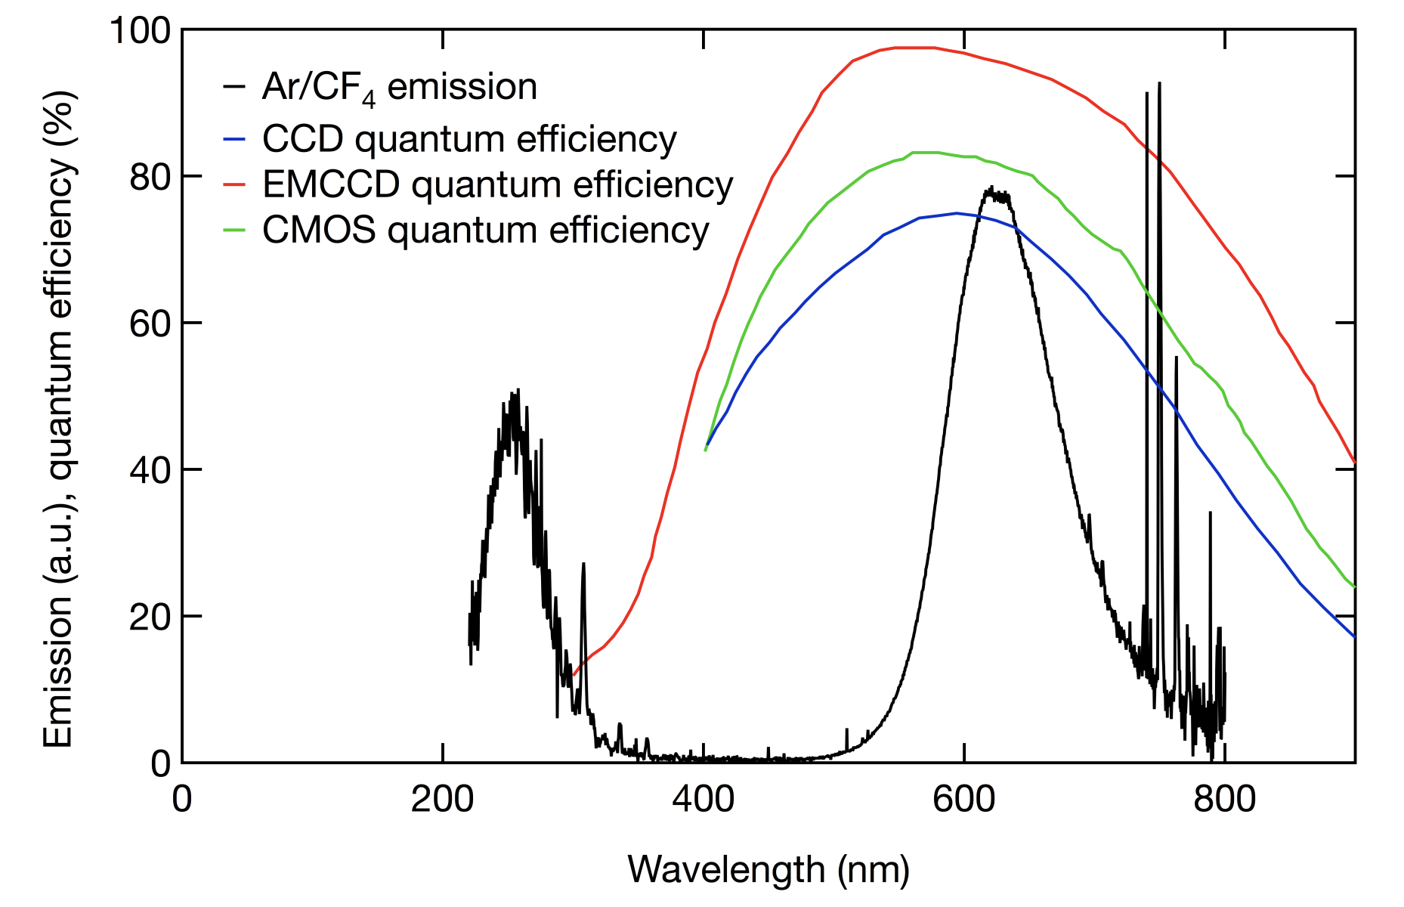
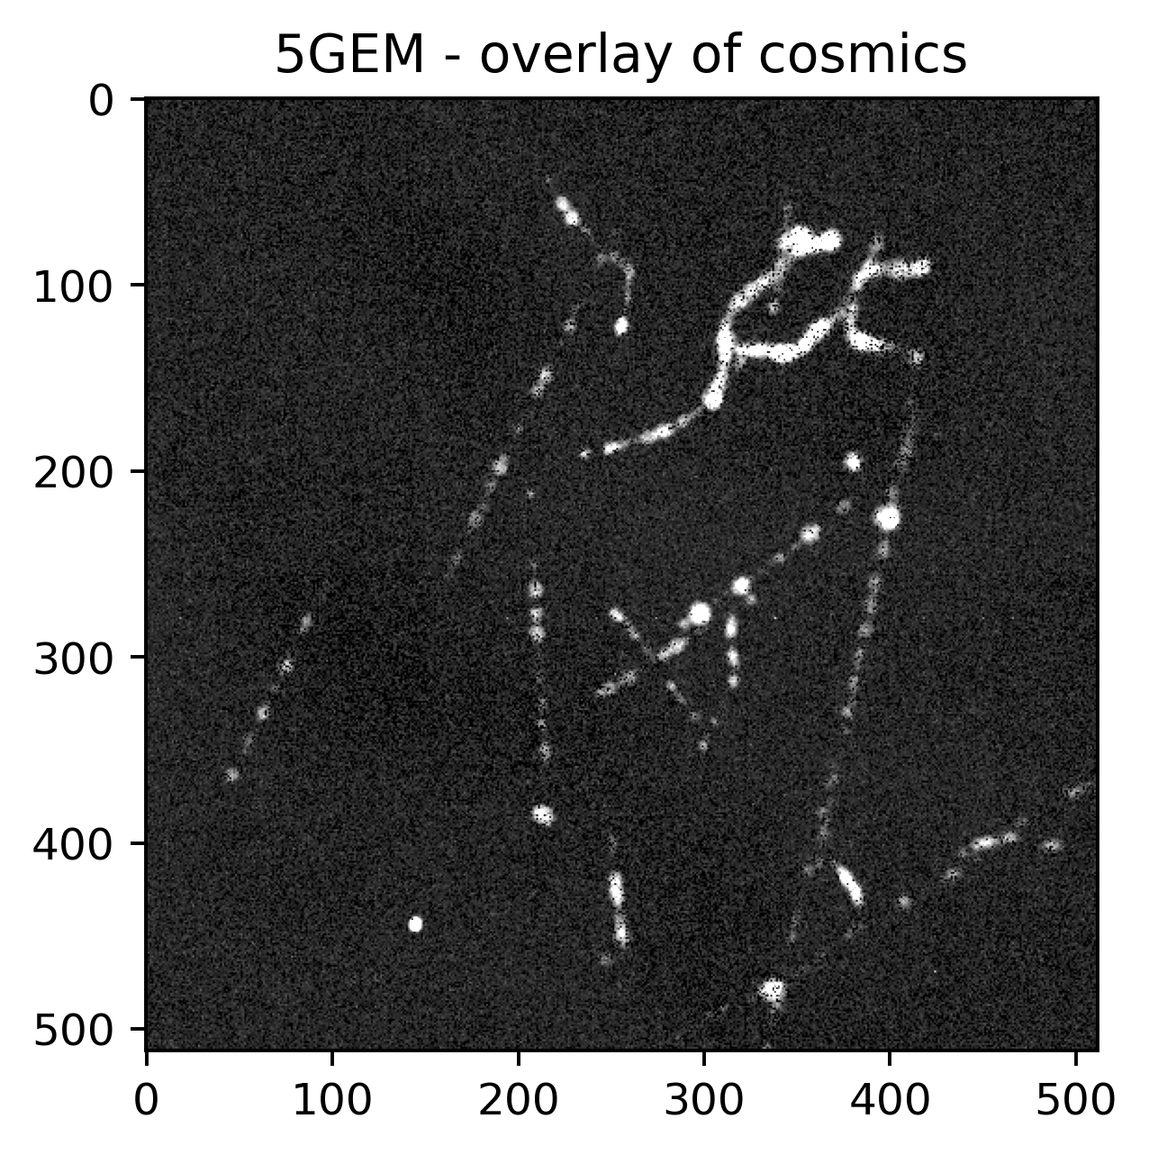
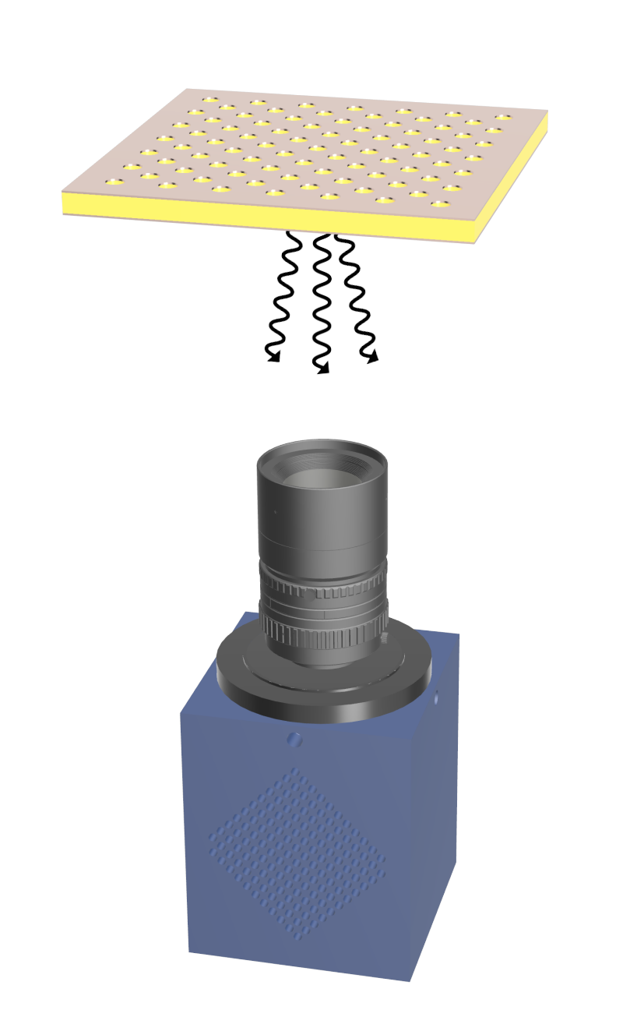
3
Optical Readout
Gas scintillation spectra need to be matched with sensor QE
Lukas Lazek – ‘High-Speed Optical Readout of MPGDs for Beam Monitoring Applications’ - EP-DT Summer Student Presentations – 22.07.2025
Barco, G.
05.08.2025
Notes:
We want an alternative to CF4. Lukas reference!!! Make explicit primary and secondary scintillation

Slide 4
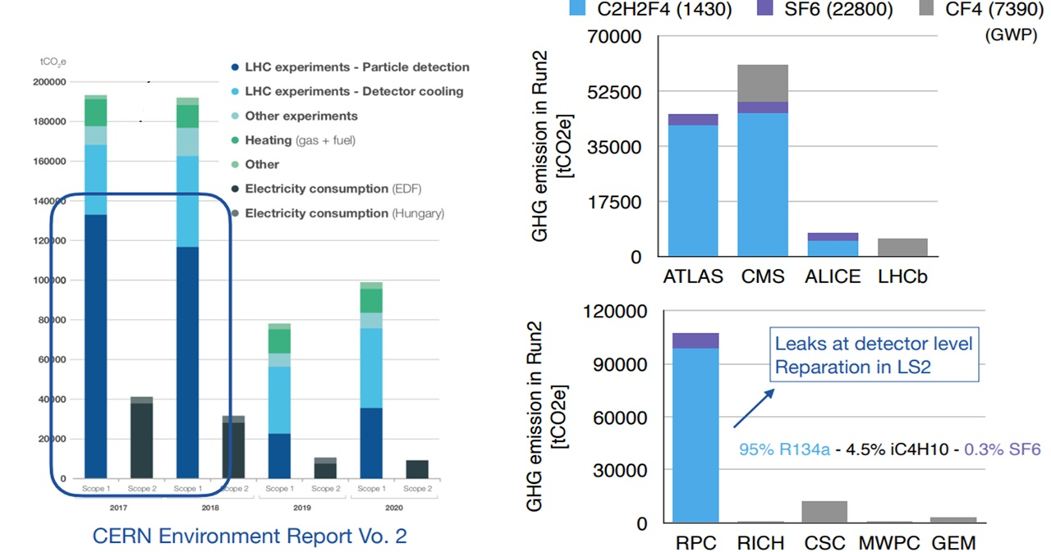
4
Environmental Point of view
Beatrice Mandelli– ‘Exploration of alternatives to greenhouse gases’ – 3rd International Conference on
Detector Stability and Aging Phenomena in Gaseous Detectors - 09.11.2023
05 - 08 - 2025
Barco, G.
Notes:
Reference!

Slide 5
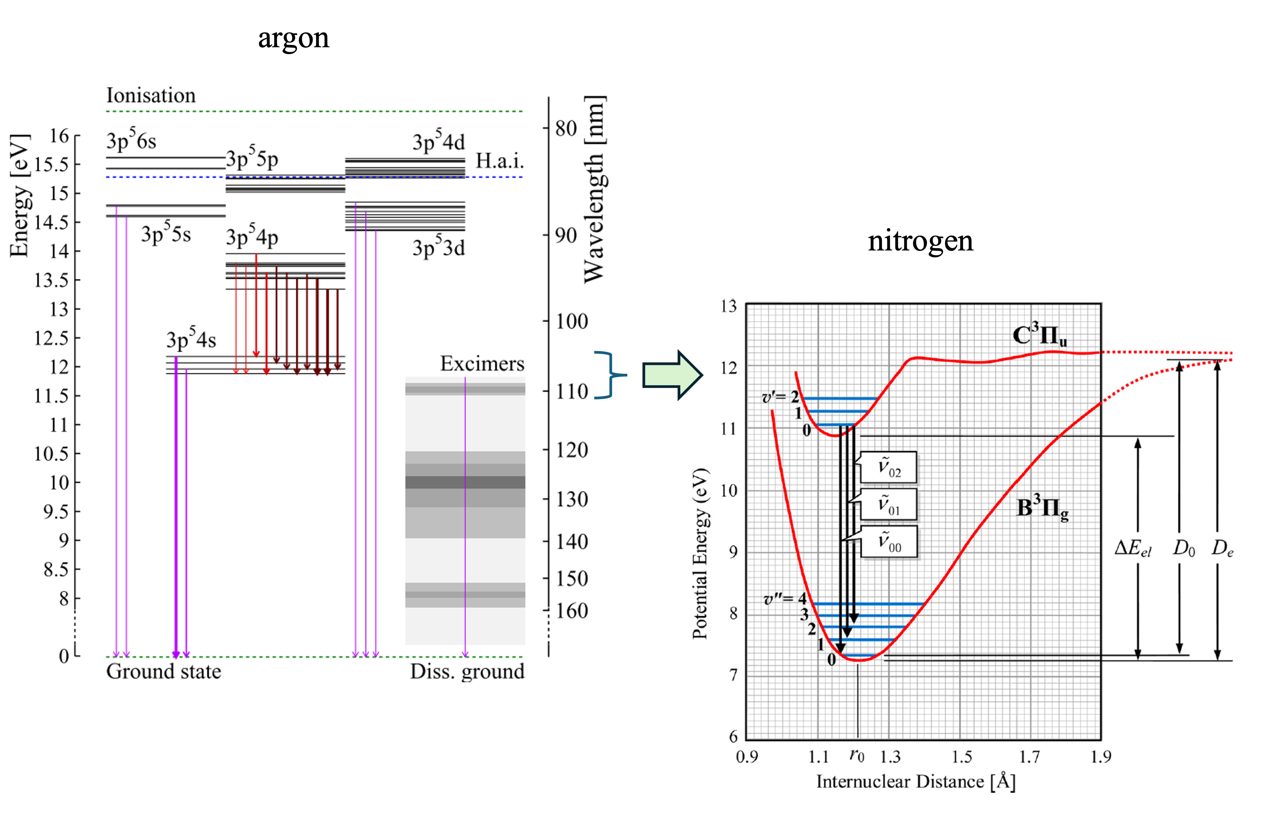
5
Nitrogen deactivates the Ar emission and scintillates on its own
05 - 08 - 2025

Slide 6
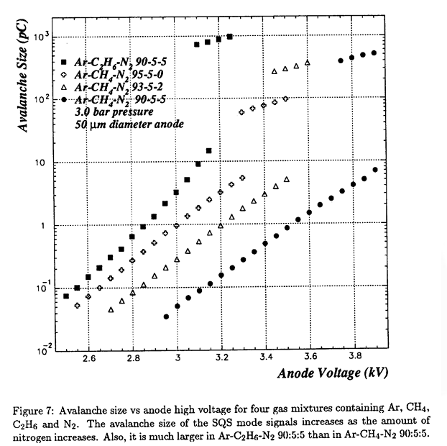
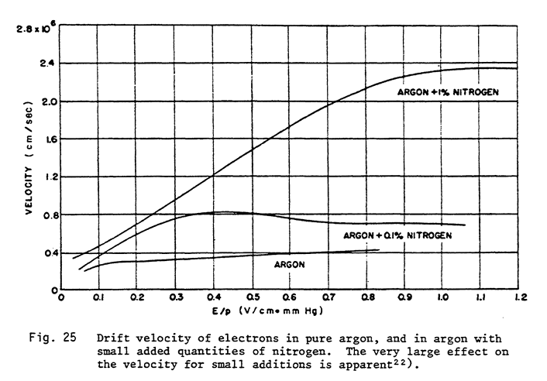
6
Previous studies of electrical properties of N2 mixtures
Avalanche size
Drift Velocity
T. Zhao, A study of gas mixtures for ATLAS MDT, Atlas internal note, 1995
F. Sauli – CERN Yellow paper - 1977
Barco, G.
Notes:
A possible solution, what will I add to this knowledge? Scintillation properties have to be studied by spectroscopy, and by that we can study the effectiveness of the quenching. Why? Optical readout.

Slide 7
Set-up

Slide 8
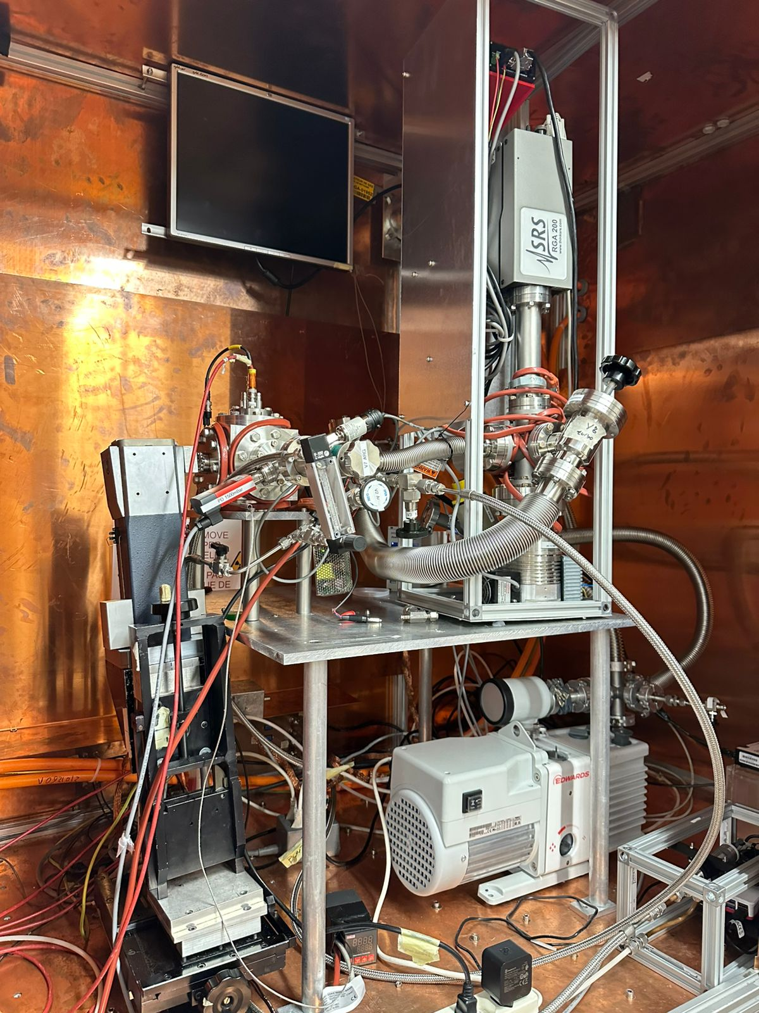
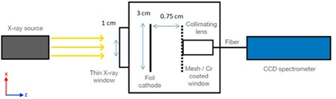
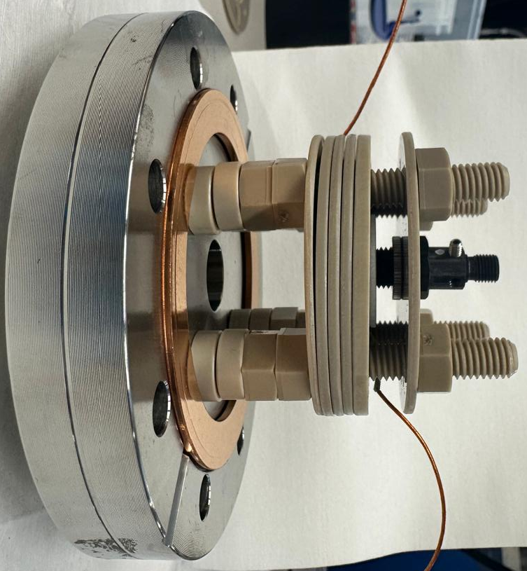
8
RGA = Residual Gas Analyzer
X-rays
Fiber
05 - 08 - 2025

Slide 9
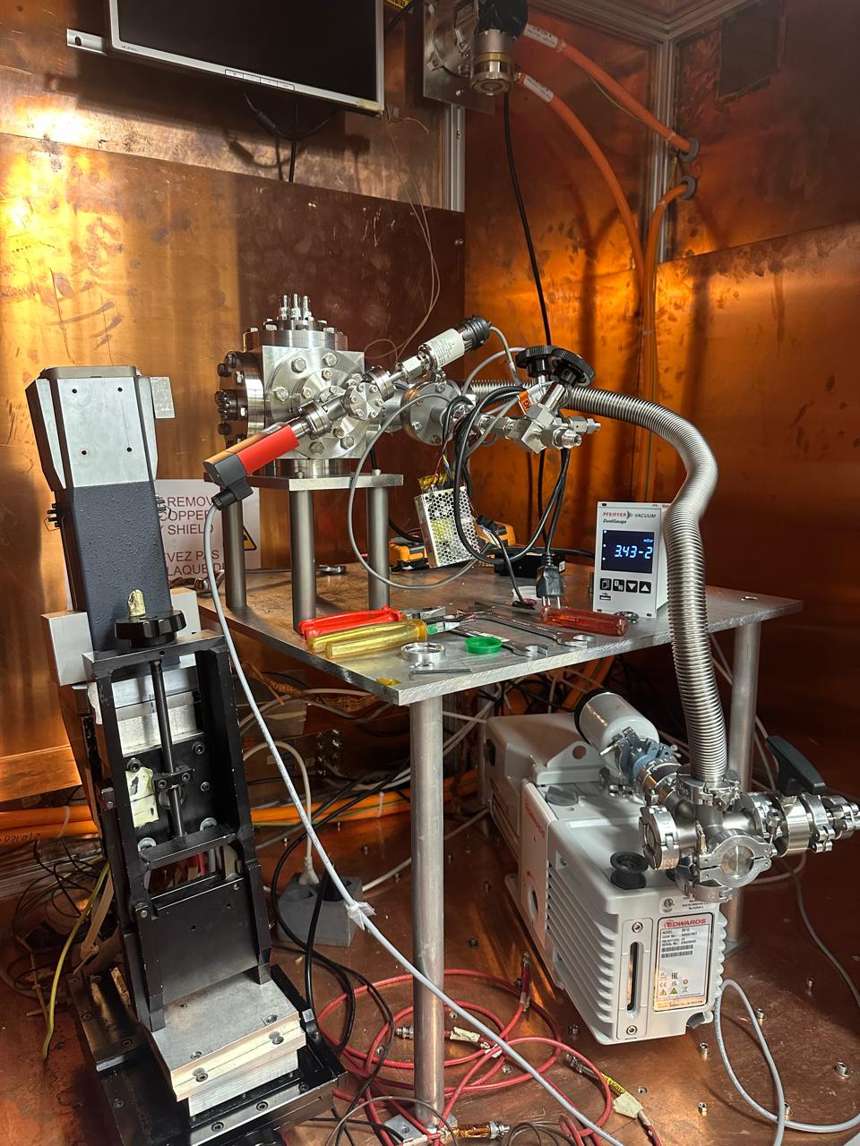
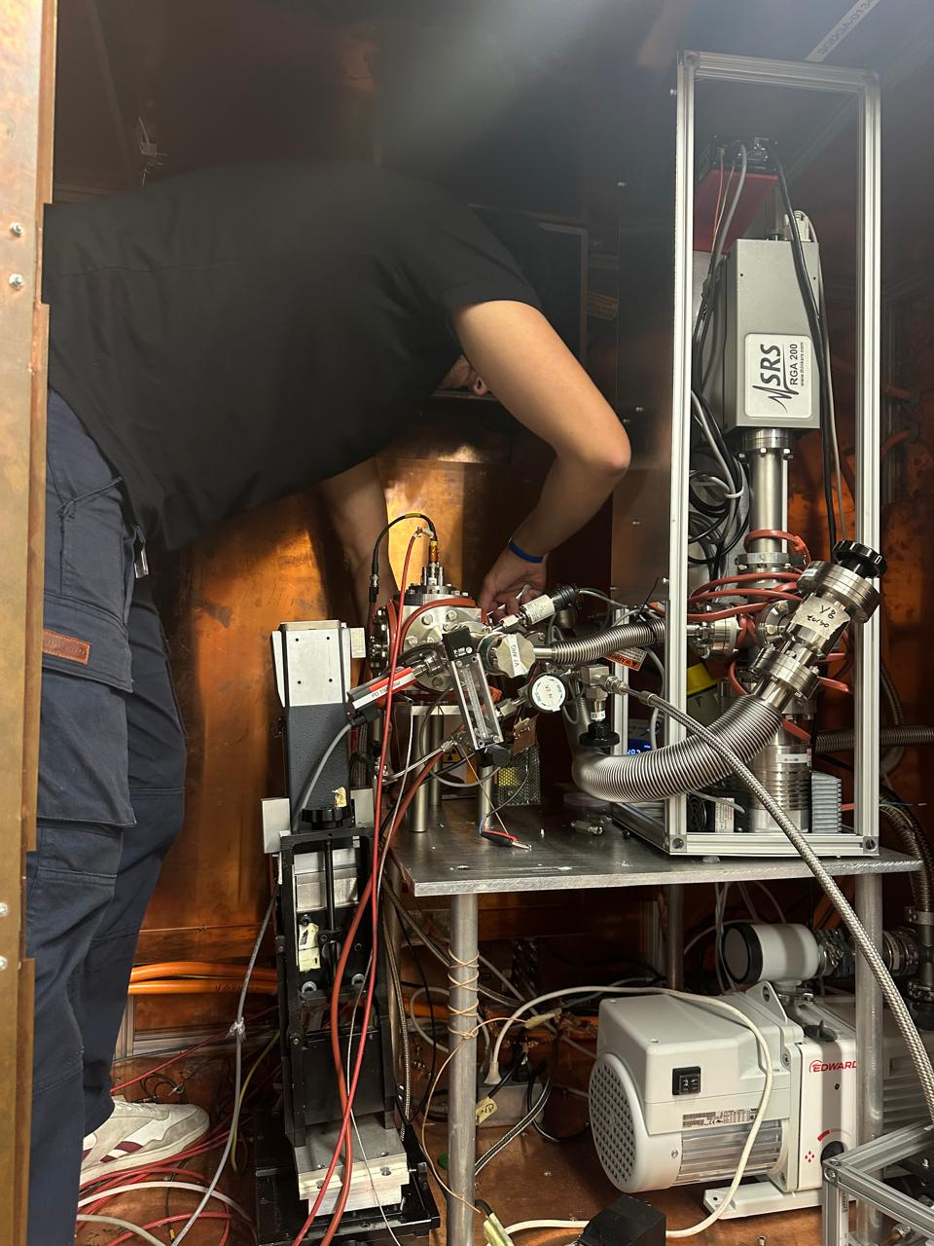
9
Barco, G.
05 - 08 - 2025

Slide 10
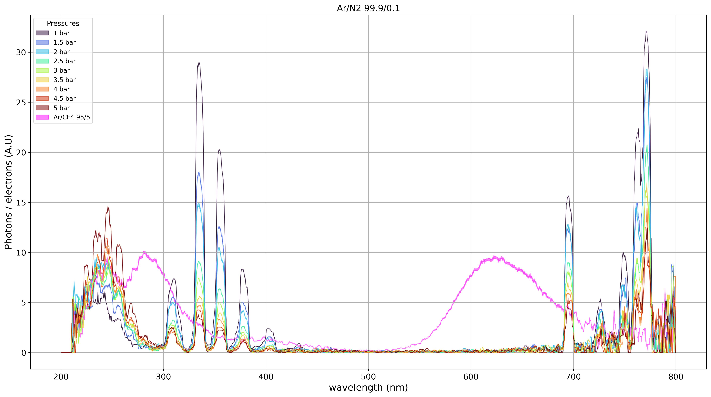
10
Barco, G.
05 - 08 - 2025

Slide 11
11
Nitrogen
Argon
CF4
Nitric Oxide
Barco, G.
05 - 08 - 2025

Slide 12
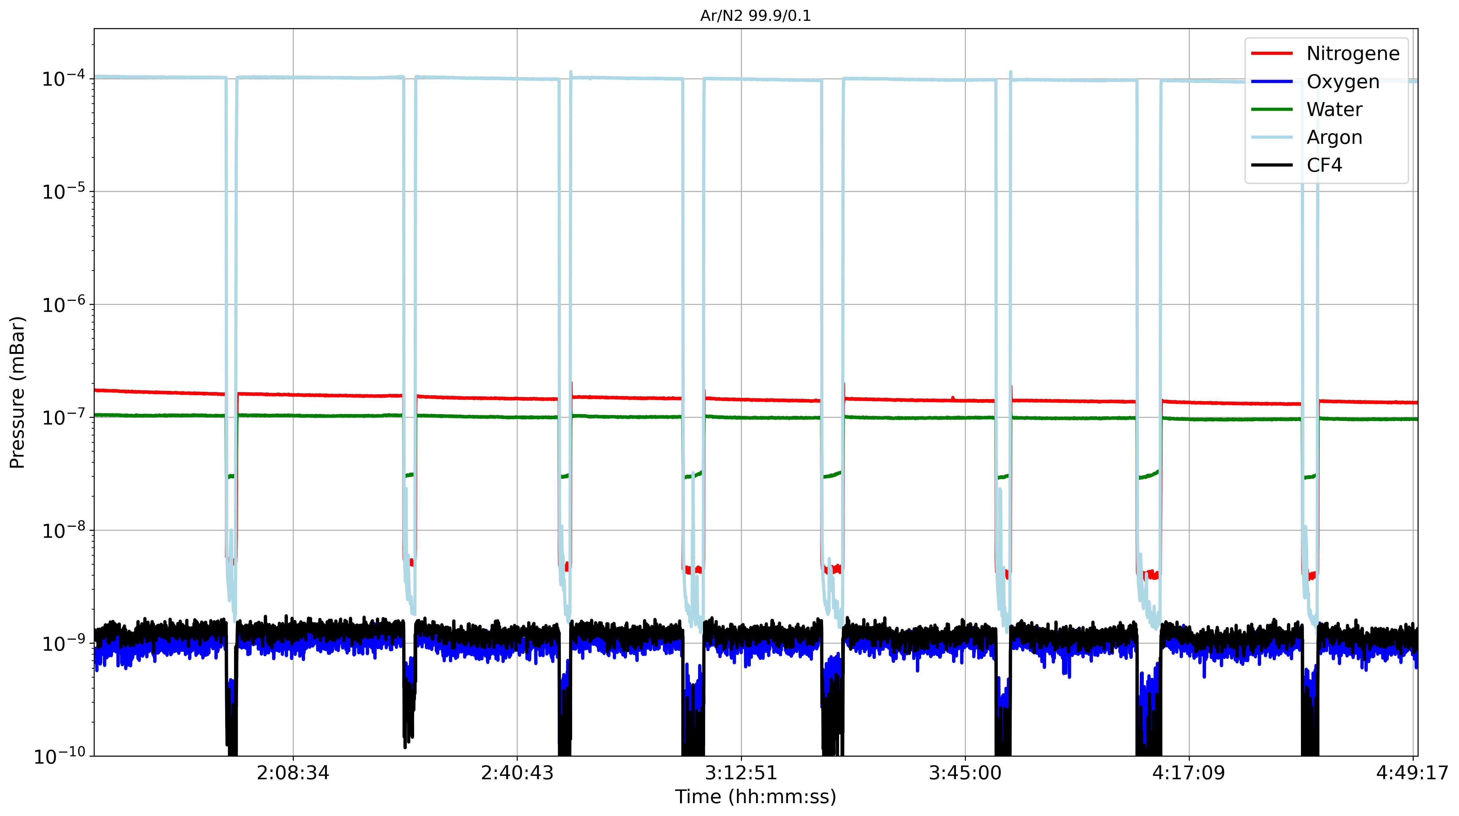
12

Slide 13
Results:
Field dependence of scintillation spectra in Ar/N2 mixture
Notes:
We might expect recombination if the are space charge, but we don’t expect it in primary scintillation

Slide 14
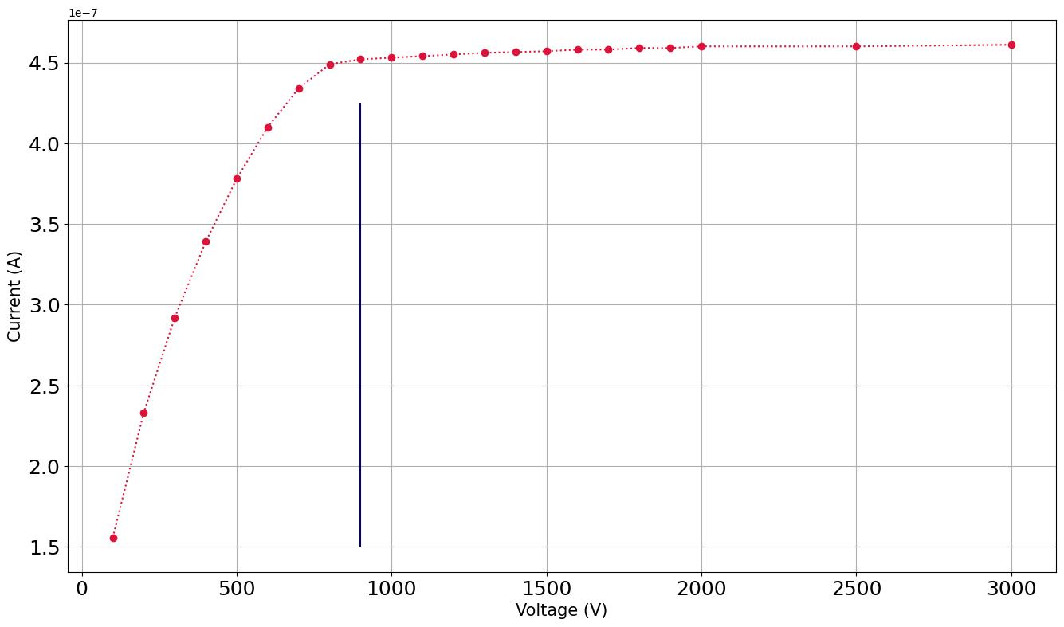
14
Saturation Current
Max. Collection Field
Barco, G.
05 - 08 - 2025

Slide 15
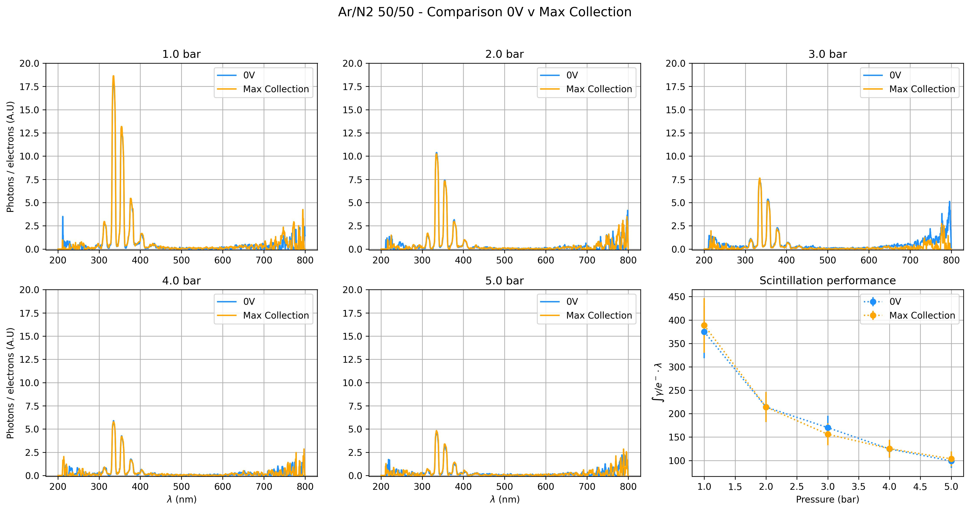
15

Slide 16
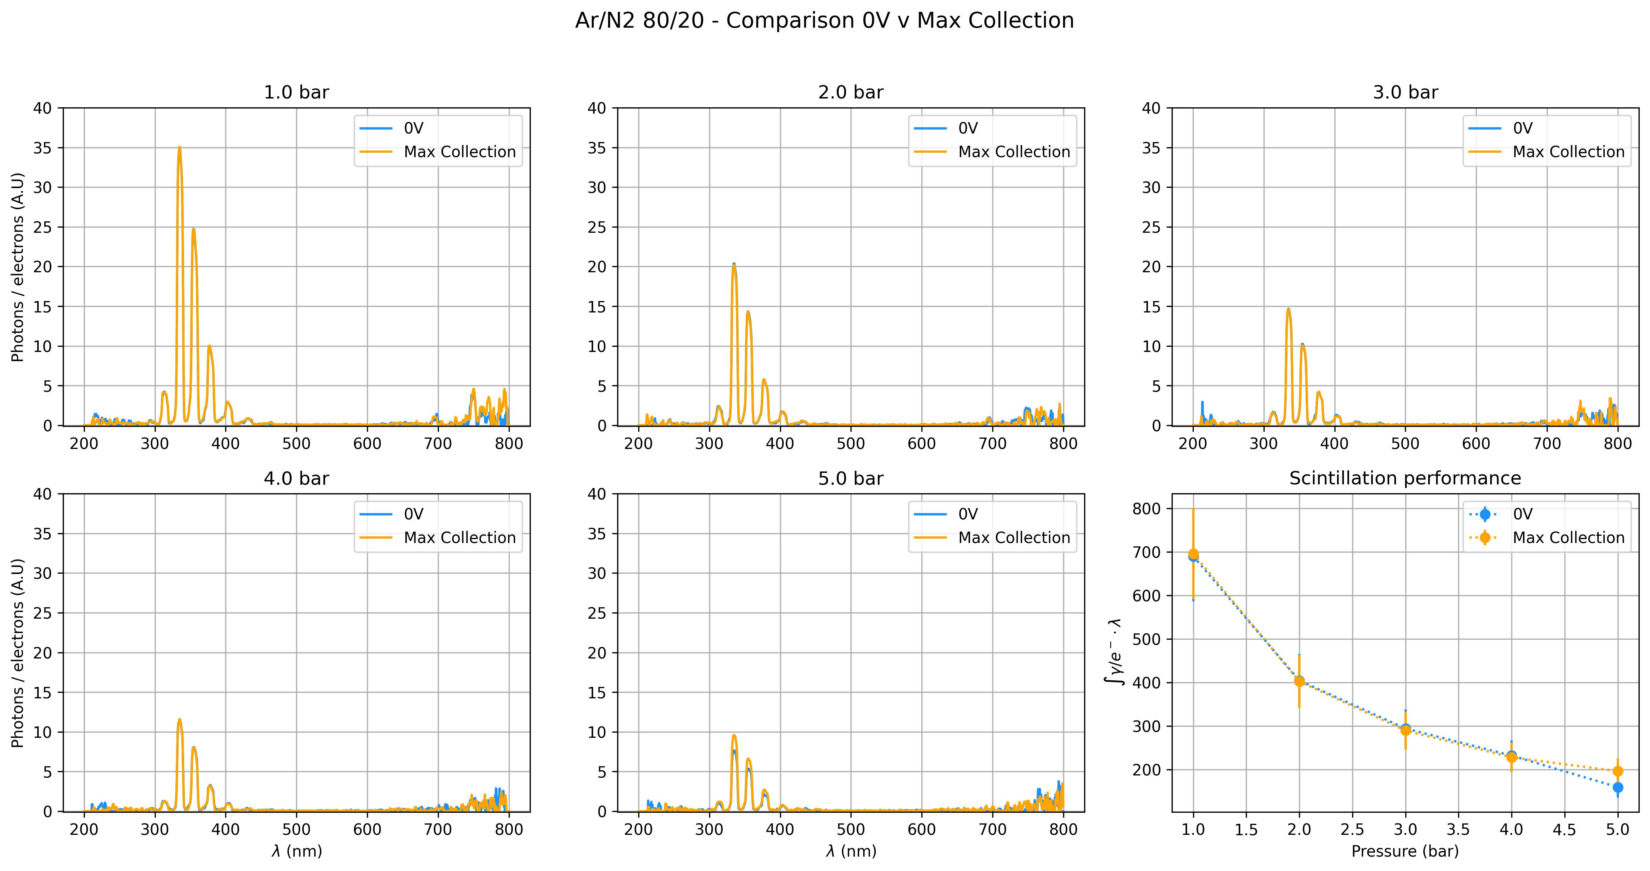
16

Slide 17
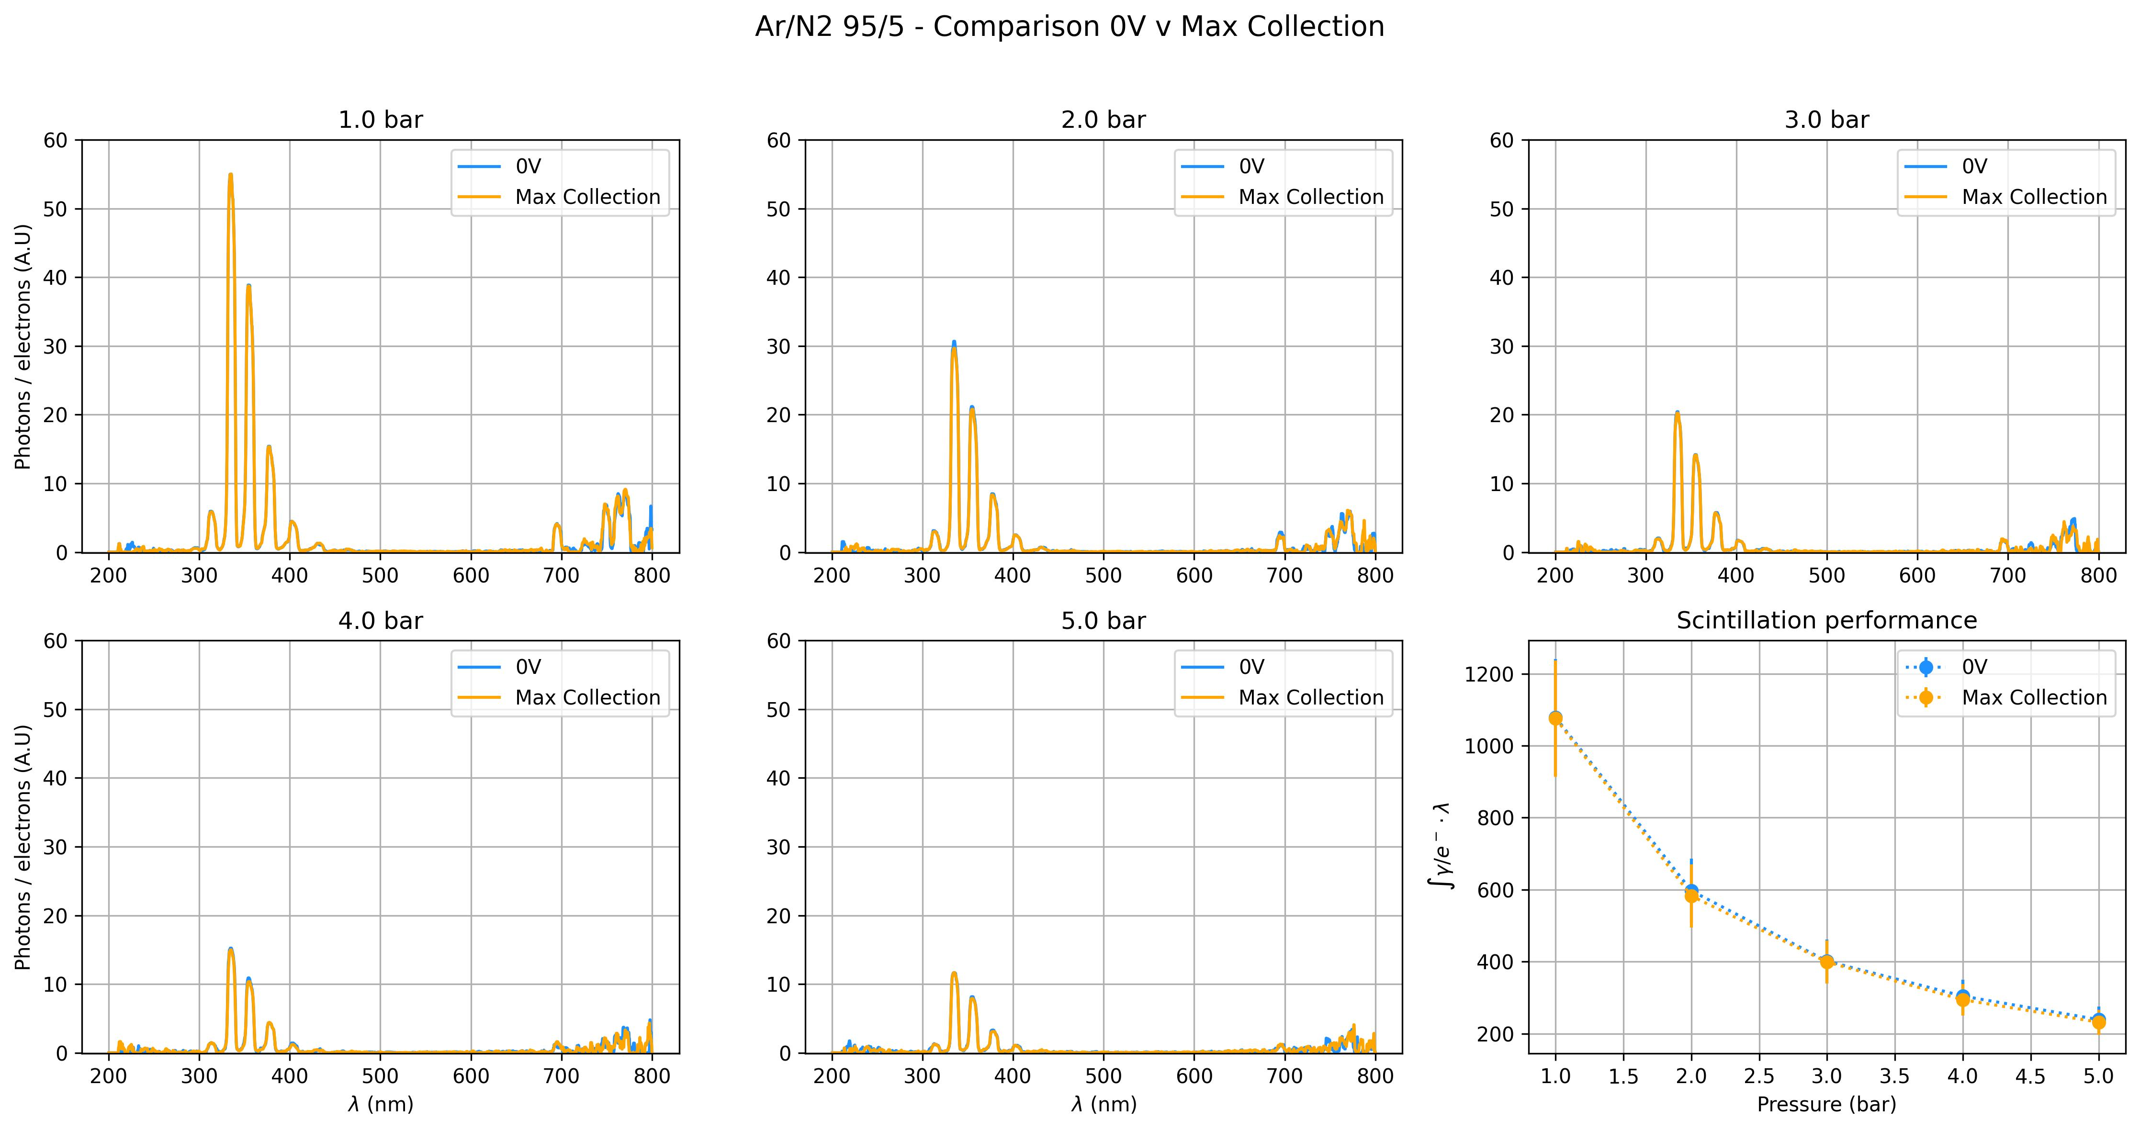
17

Slide 18
Results:
Effect of Nitric Oxide (NO) contamination in Ar/N2 scintillation spectra
Notes:
We do not put NO, it formed in the chamber

Slide 19
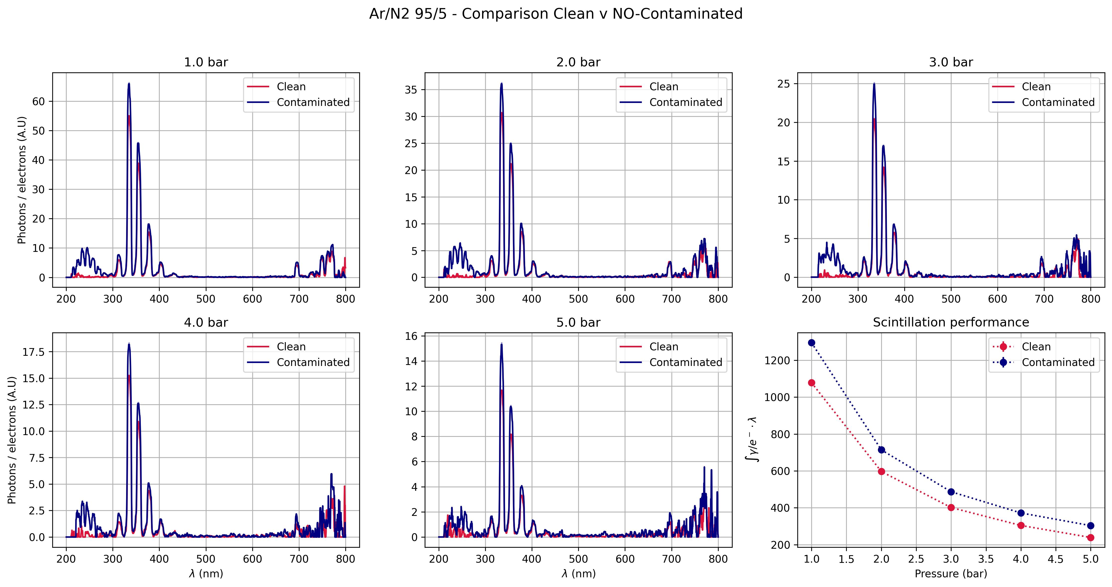
19
~1,5 ppm
< 0,1 ppm

Slide 20
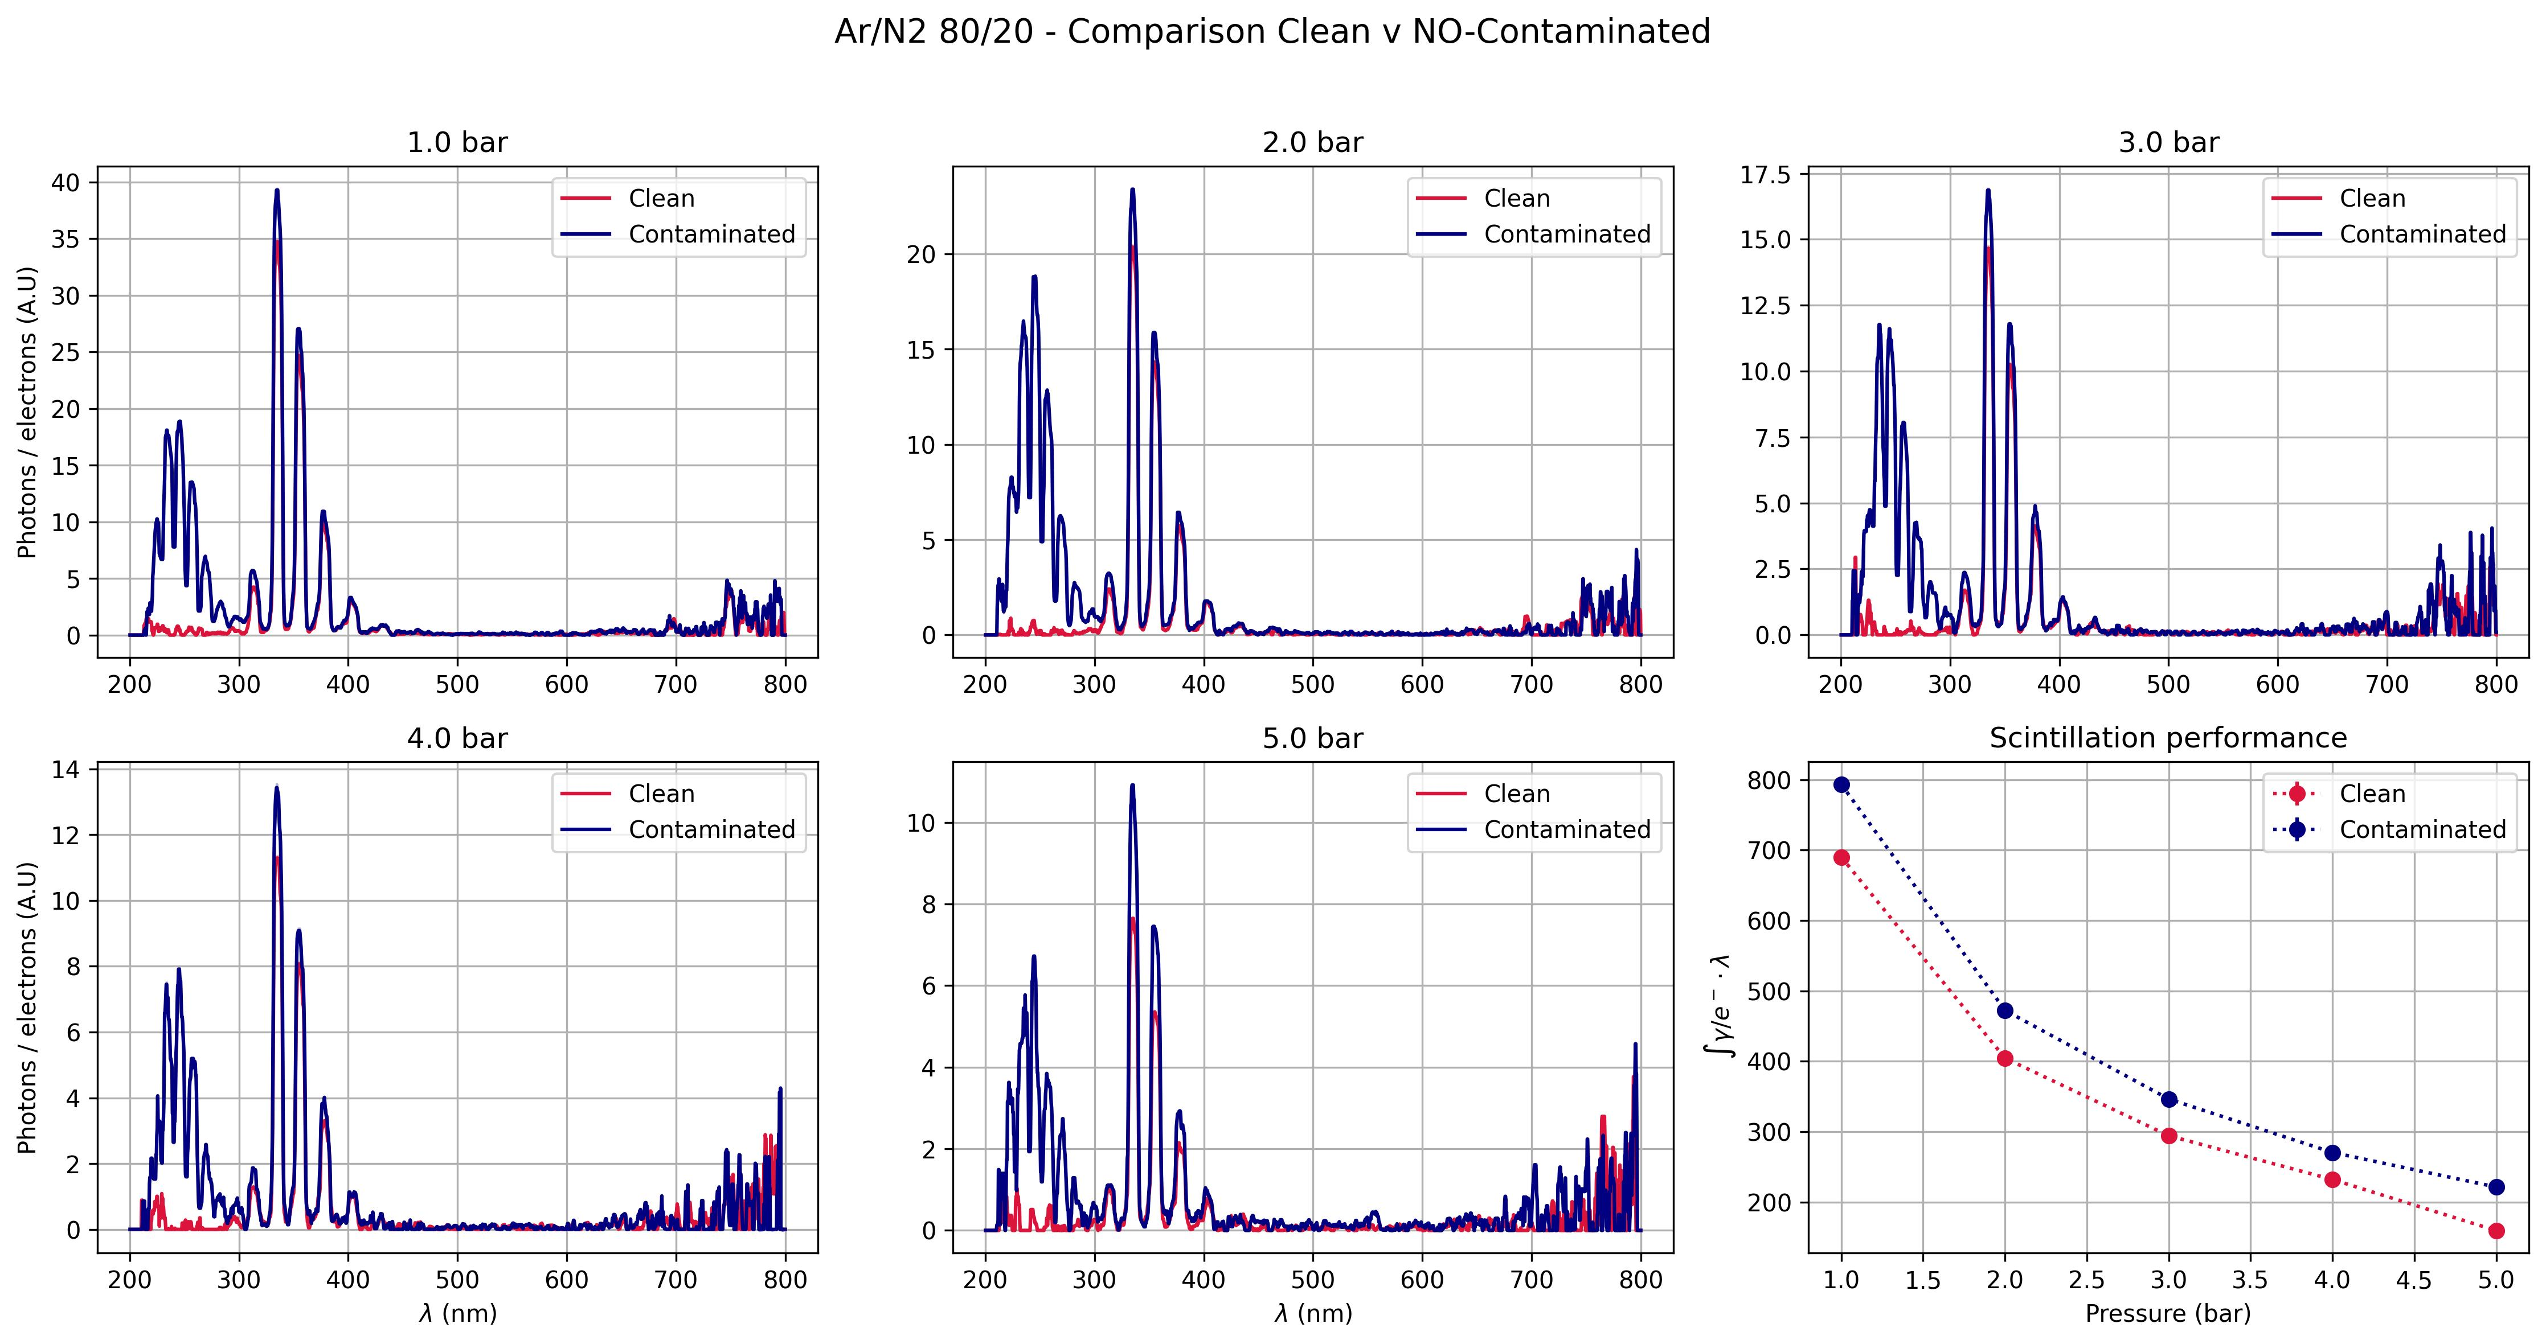
20
~6 ppm
< 0,6 ppm

Slide 21
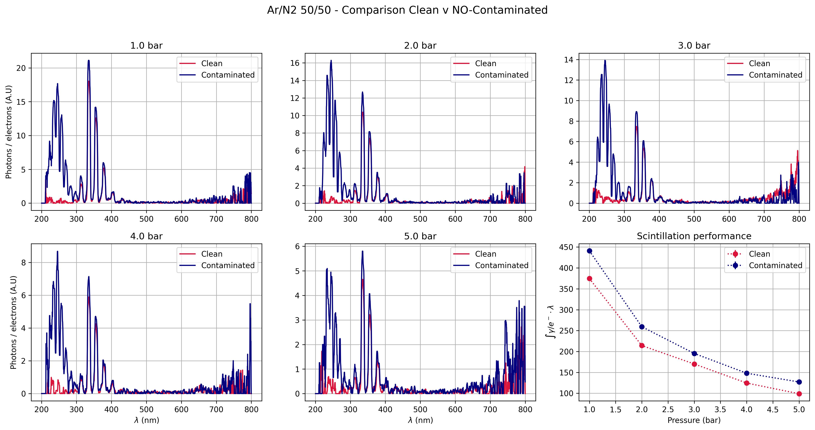
21
~10 ppm
< 1 ppm

Slide 22
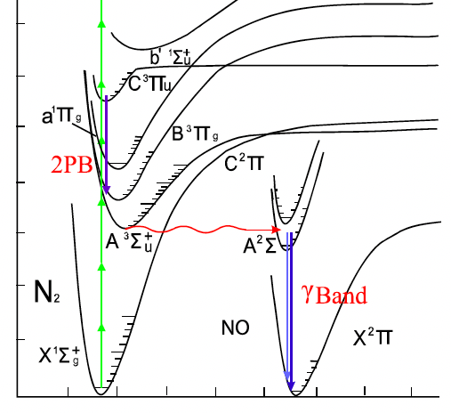
22
Scintillation mechanism
Sequence of transitions
[*]
[*] B. Wen, H. Eilers – ‘Potential interference mechanism for the detection of explosives via laser-based standoff techniques’ -Appl Phys B (2012) 106:473–482 DOI 10.1007/s00340-011-4713-y
Barco, G.
05 - 08 - 2025

Slide 23
23
NO contamination
Ar Scintillation
100 nm – 150 nm
NO Scintillation
200 nm – 300 nm
N2 Scintillation
300 nm – 450 nm
Barco, G.
05 - 08 - 2025

Slide 24
Results:
Scintillation yield of Ar/N2 mixtures

Slide 25
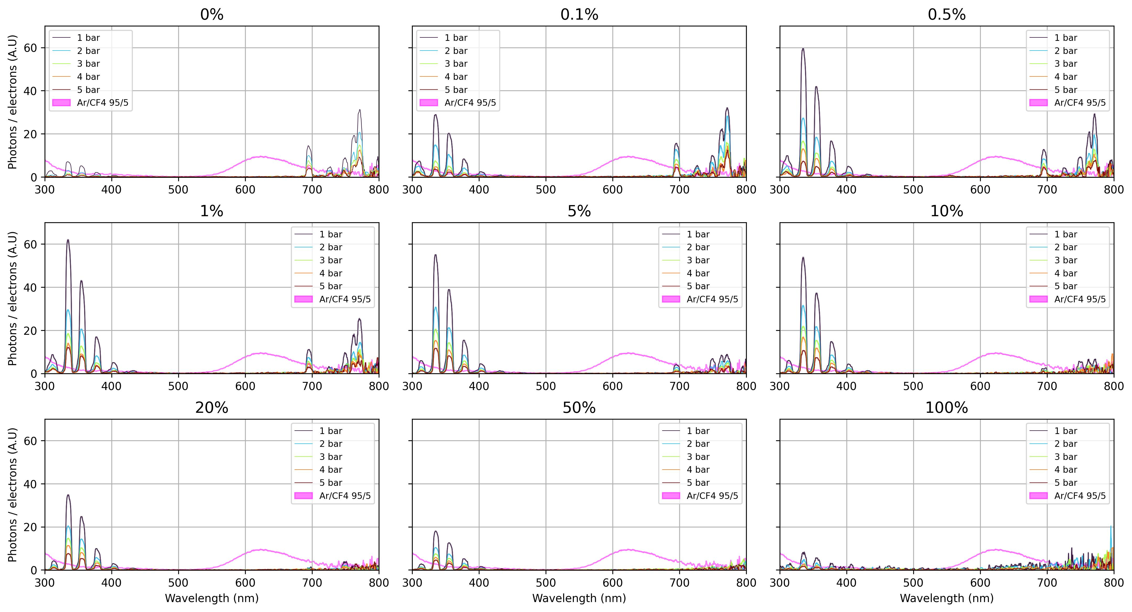
25
Barco, G.
05 - 08 - 2025

Slide 26
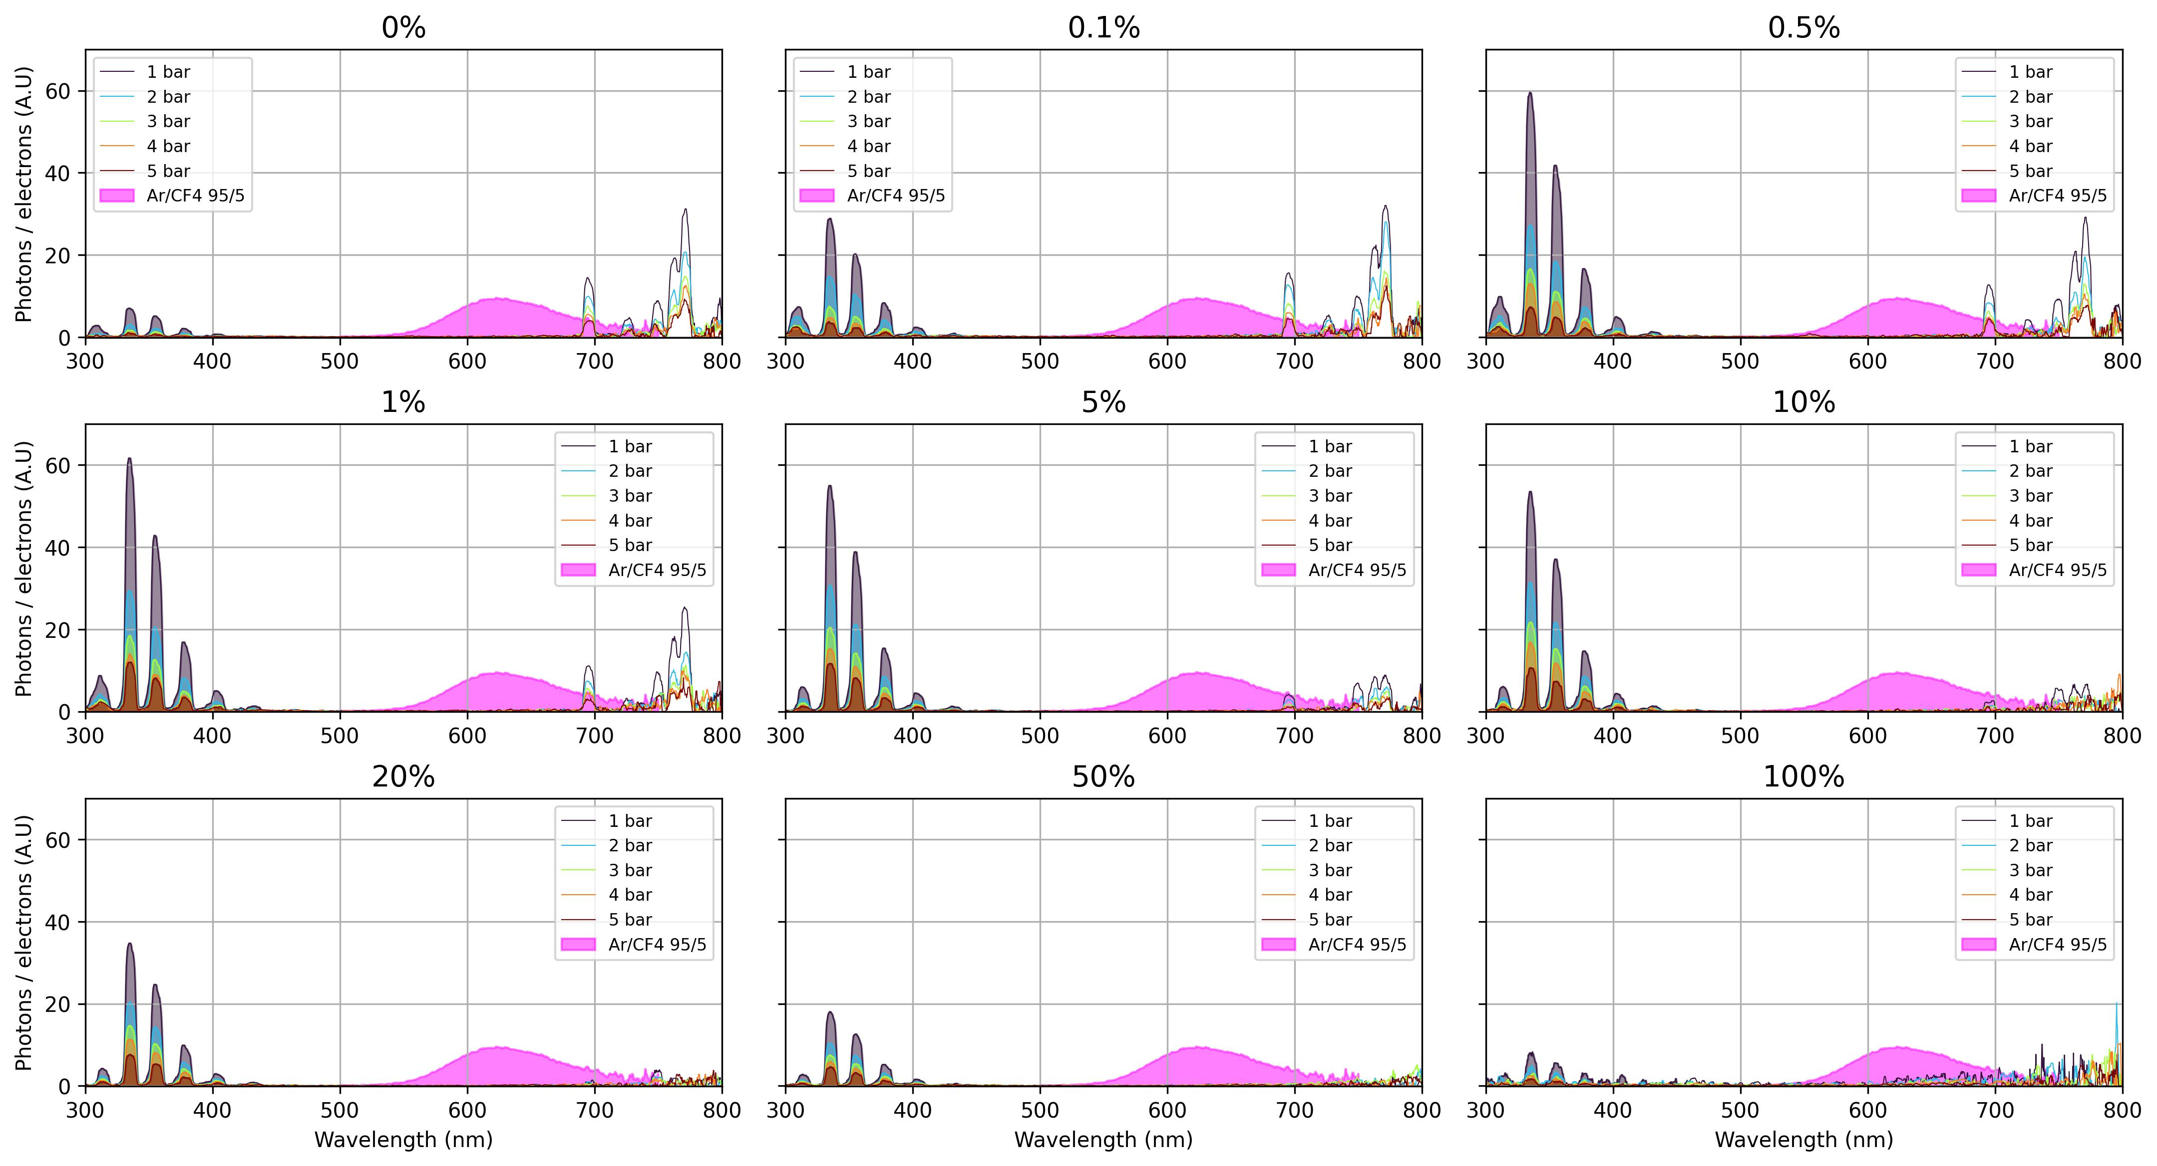
26
05 - 08 - 2025
Barco, G.
Notes:
You are comparing INTEGRATION of the spectrums

Slide 27
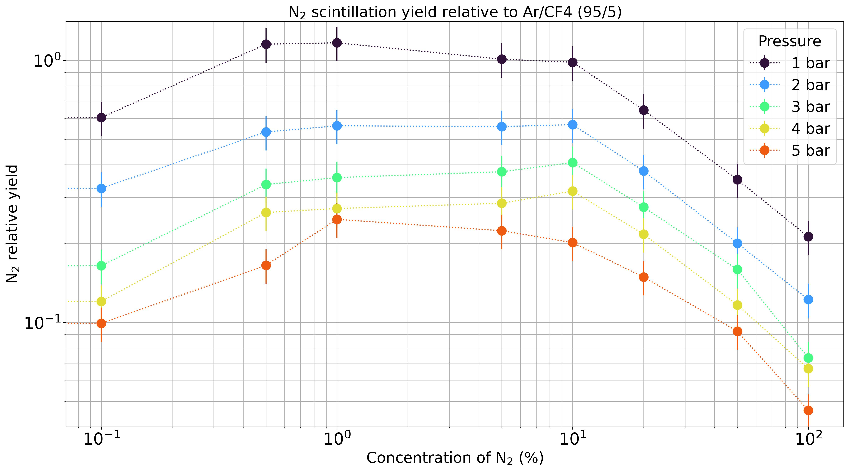
27
Barco, G.
05 - 08 - 2025
Notes:
Comparison of spectrums, not the addition of N2

Slide 28
Conclusions
28
N2 seems to be a nice VUV- quencher, producing a wavelength-shift to the range of 300-450nm.
Ar/N2 mixtures present a plateau between 0,5% and 10% where the best scintillation yield is measured. Meanwhile, this yield presents a dependence with pressure, being 1 bar its best performance.
Small quantities of N2 allow a scintillation yield much greater than pure N2 and pure Ar.
Nitric Oxide contamination at ppm scale produces UV-light that can affect the stability of the detector. But it could also be another useful source of scintillation. Further research is required.
Barco, G.
05 - 08 - 2025

Slide 29
Outlook
29
A study of secondary scintillation of Ar/N2 gas mixtures is scheduled to start in the next few weeks. Many mechanisms seen in Primary Scintillation are expected to be the same.
Other gas mixtures will be tested using this set-up.
Scintillation of Nitric Oxide and its capacity to be used as a useful source is reserved for research to be done.
Barco, G.
05 - 08 - 2025

Slide 30
Thank you!
Genaro Barco
Supervisors:
Florian Brunbauer
Pablo Amedo
Diego Gonzalez Diaz
Notes:
Add DRD1 logo

Slide 31
Appendix

Slide 32
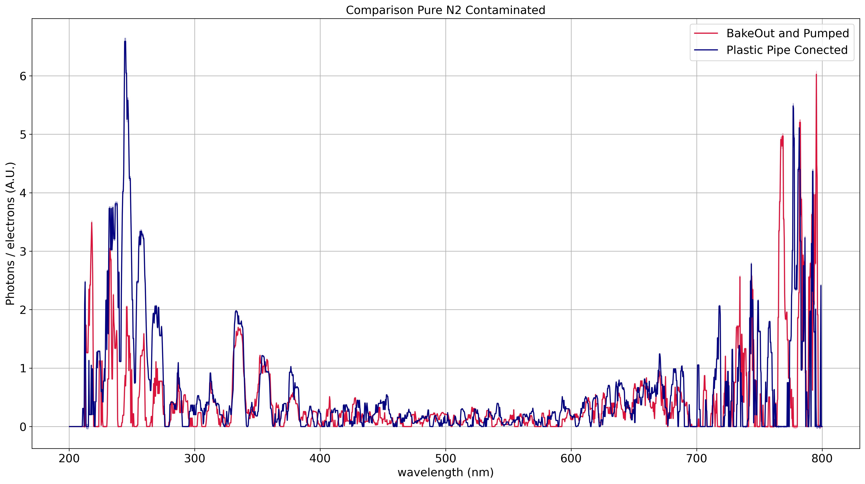

Slide 33
30 ppm
10 ppm

Slide 34
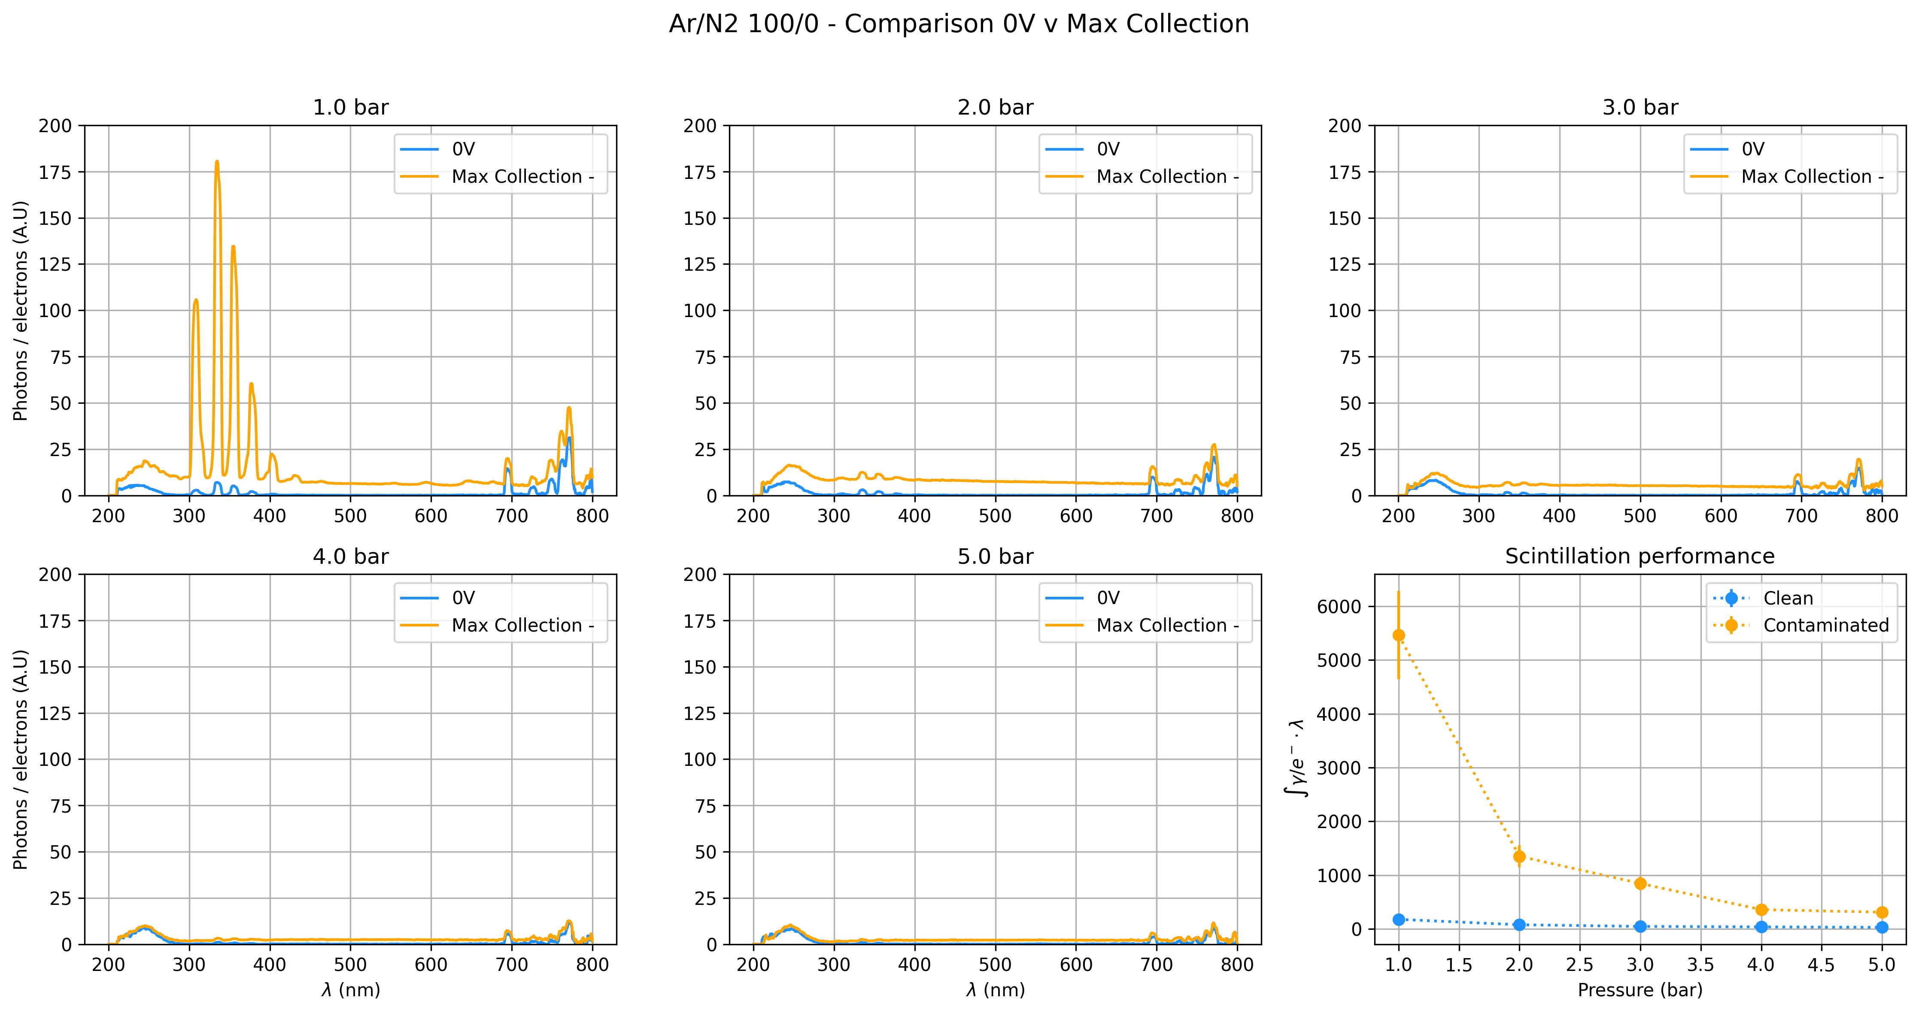
Notes:
Legend in bottom right plot

